Slide 1
Transfer Learning with Convolutional Neural Networks
Vivek Viswanathan
Daniel Serna
Steven Cocke
Kevin Mendonsa

Slide 2
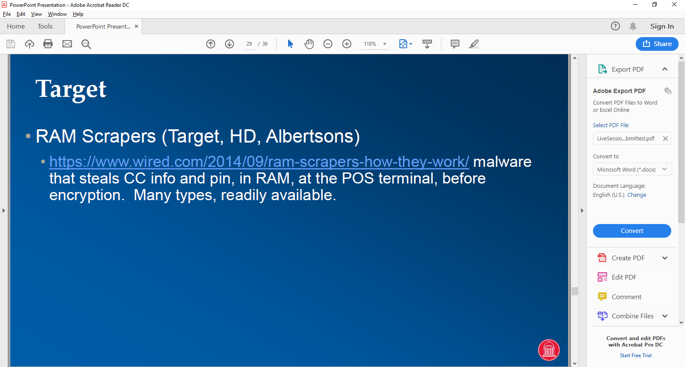
AGENDA
DEEP LEARNING MYTHS
NEURAL NETWORK - A BRIEF OVERVIEW
CONVOLUTIONAL NEURAL NETWORK - A BRIEF OVERVIEW
WHAT IS TRANSFER LEARNING WITH CNN? – CONCEPT & IDEA
TRANSFER LEARNING: PROCESS & STEPS
BENEFITS & SUMMARY
QUESTIONS

Slide 3
Deep Learning Myths
MYTH
One cannot do deep learning unless there are million labeled examples for your specific problem.
TRUTH
One can learn many useful representations from unlabeled data
Learned representations can be transferred from a related task
Train on an adjacent surrogate object which is easy to generate labels

Slide 4
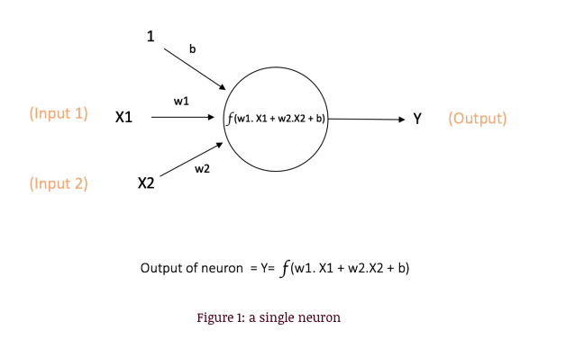
Neural Networks – A Brief Overview
X1, X2 – the inputs
w1,w2 – the weights
b – the bias (also weight)
f – activation function
Y - output
Activation Functions Purpose
To introduce non-linearity into the output of the neuron
Examples include sigmoid, tanh, and ReLU

Slide 5
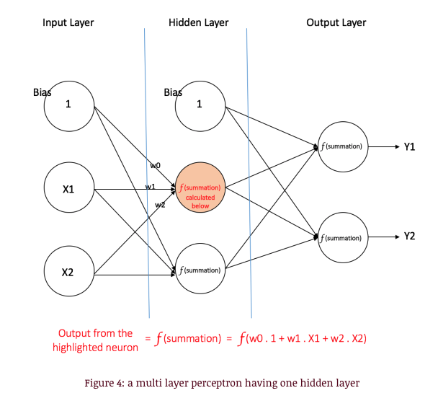
Neural Networks – A Brief Overview
Input nodes: provide information from outside world. No computation.
Hidden nodes: perform computation and transfer information from input nodes to output nodes. Generally 1 more more hidden layers.
Output nodes: more computation and transfer information from network to outside world.

Slide 6
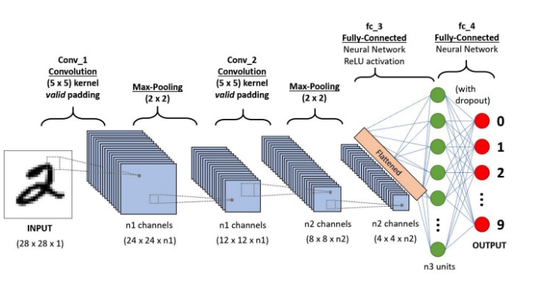
Convolutional Neural Network Brief Overview
CNN/ConvNet is a deep learning algorithm which is used to differentiate objects/aspects within an input image via assigning learned weights and biases
The main idea behind CNN is that it reduces the images into forms much easier to process, without losing features which are critical for good prediction

Slide 7
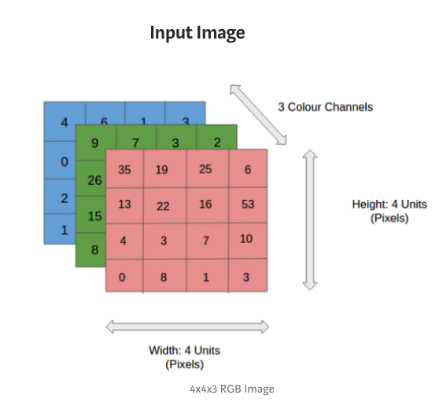
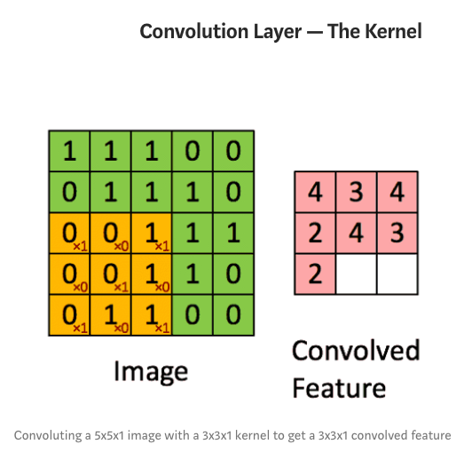
Convolutional Neural Network – The Kernel

Slide 8
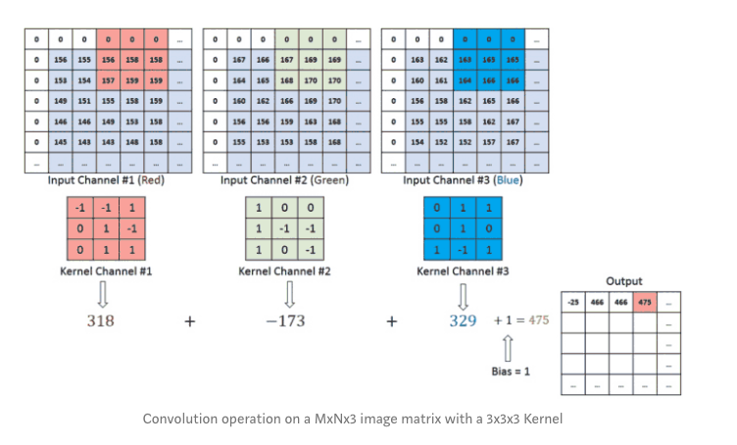
Convolutional Neural Network – Kernel
The Kernel K is the colored matrix covering a portion of the larger matrices.
It traverses the input channel and performs matrix multiplication.
The value is then stored in the output of the layer as shown in the bottom right.

Slide 9
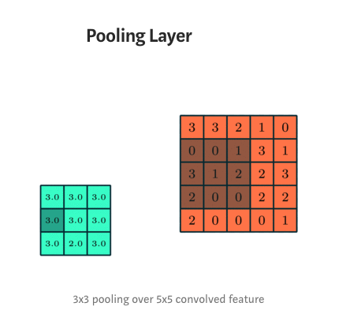
Convolutional Neural Network – Pooling Layer
Used to reduce the size of the convoluted feature.
Decreases the computational power required.
Examples: max pooling and average pooling

Slide 10
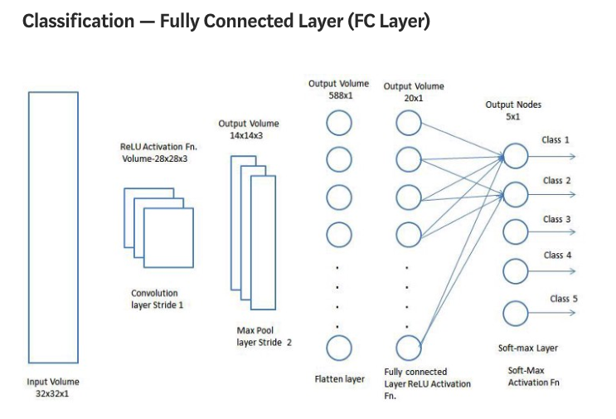
Convolutional Neural Network – Fully Connected Layer
Examples of CNNs:
ZFNet
ResNet
GoogLeNet
VGGNet
AlexNet
LeNet

Slide 11
What is Transfer Learning with CNN?
Leverage a model trained on a large dataset and transfer its knowledge to a smaller dataset.
Freezing the lower convolutional layers of the network and training just the last few layers that make a prediction when applied to object recognition with CNN.
Based on the principle that the convolutional layers extract more general, low-level features that are applicable across images — such as edges, patterns, gradients, while the higher layers identify more specific features within an image such as eyes, wheels etc.

Slide 12
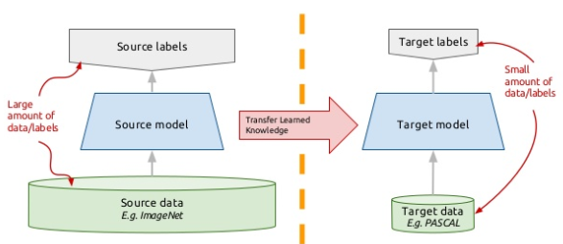
Transfer Learning: The Concept
Instead of training a deep network from scratch for a task:
Adopt a network trained on a different domain for a different source task
Adapt it for your domain and your respective target task
Some Variations:
Same domain, different task
Different domain, same task

Slide 13
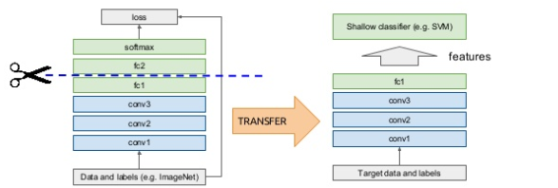
Transfer Learning: Off the Shelf features
Idea: Use outputs of one or more layers of a network trained on a different task as generic feature detectors. Train a new shallow model on these features

Slide 14
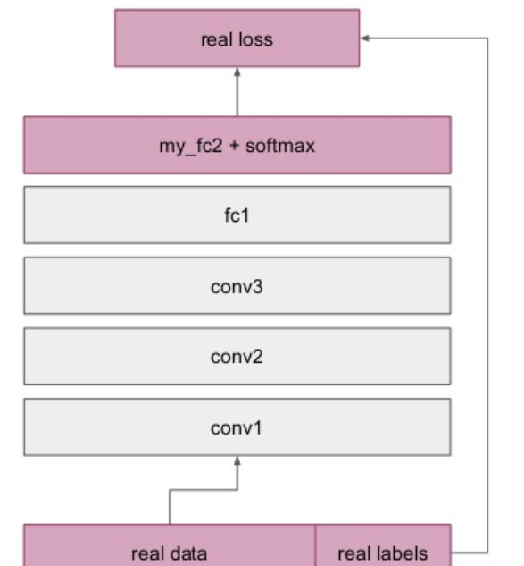
Fine-tuning: Supervised task adaptation
Train deep net on an “adjacent” task where it is easy to obtain labels using the standard backprop
Examples are ImageNet classification
Pseudo classes from augmented data
Slow feature learning
Cut off the upper layers of the network and replace with specific layers for the respective target domain
Fine-tune the model with labels for the target domain until validation loss starts increasing

Slide 15
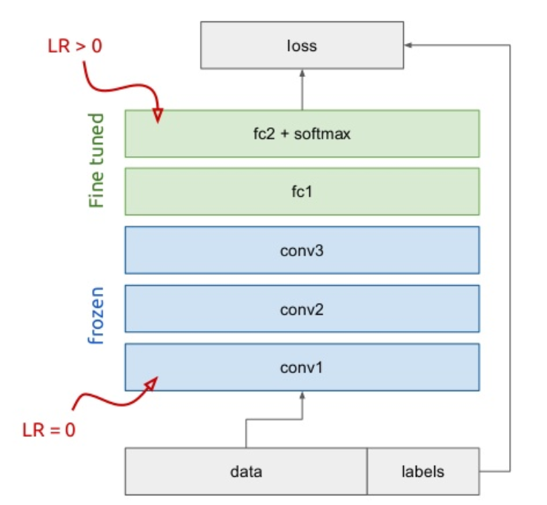
To Freeze or Fine-tune?
Bottom “n” layers can be frozen or fine tuned
Frozen: not updated during backprop
Fine-tuned: updated during backprop
Which to do depends on the target task
Freeze: target task labels are scarce and want to avoid overfitting
Fine-tune: target task labels are more abundant
In general we can set learning rates to be different for each layer to find a tradeoff between freezing and fine tuning

Slide 16
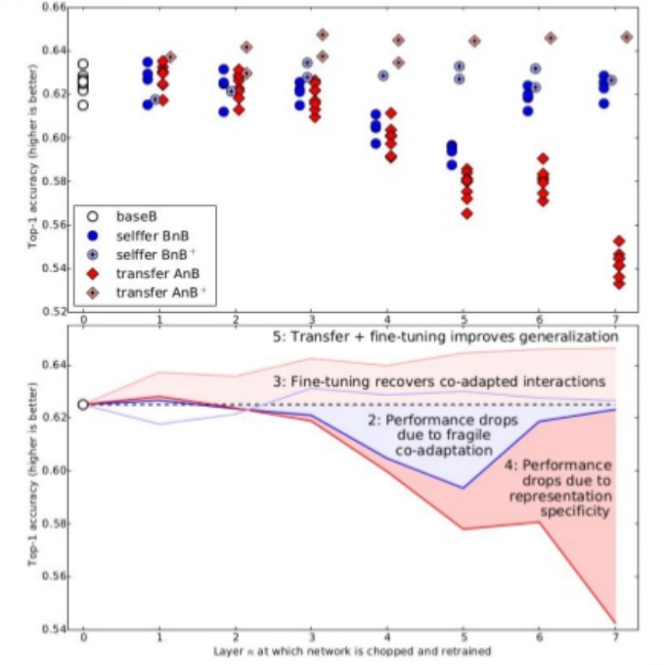
Feature Transferability
Lower layers: more general features. These transfer very well to other tasks
Higher layers: More task specific
Fine-tuning improves generalization when sufficient examples are available
Transfer learning and fine tuning often lead to better performance than training from scratch on the target dataset
Even features transferred from distant tasks are often better than random initial weights.

Slide 17
Transfer Learning: Process & Steps
Load in a pre-trained CNN model trained on a large dataset
Freeze parameters (weights) in the model’s lower convolutional layers
Add custom classifier with several layers of trainable parameters to model
Train classifier layers on training data available for task
Fine tune hyper-parameters and unfreeze more layers as needed
This is a widely used and successful approach that is applicable to wide range of domains.
Transfer Learning is a very useful tool and should be first tried when confronted with a new image recognition problem

Slide 18
The Steps: Data Set-up
Formatting the data correctly will determine the success or failure of the project.
The Caltech 101 dataset images are clean and stored in the correct format.
Set up the data directories correctly and PyTorch makes it simple to associate the correct labels with each class.
Separate the data into training, validation, and testing sets with a 50%, 25%, 25% split and then structure the directories

Slide 19
The Steps: Augmentation
The idea is to artificially increase the number of training images our model sees by applying random transformations to the images. Augmentation is generally only done during training (although test time augmentation is possible in the fast.ai library).
Each epoch — one iteration through all the training images — a different random transformation is applied to each training image.
This means that if we iterate through the data 20 times, our model will see 20 slightly different versions of each image.
The overall result should be a model that learns the objects themselves and not how they are presented or artifacts in the image.

Slide 20
The Steps: Image Pre-Processing
This is the most important step of working with image data.
During image preprocessing, we simultaneously prepare the images for our network and apply data augmentation to the training set.
Each model will have different input requirements that our images need to be 224x224 and normalized to a range.

Slide 21
Benefits of Transfer Learning
Can use a network trained on unrelated categories in a massive dataset and apply it to our own model i.e. Imagenet
There are low-level features that are universally shared between images. i.e. the images in the Caltech 101 dataset are very similar to those in the Imagenet dataset. The knowledge a model learns on Imagenet are easily transferable to this task.
Save resources – time and costs
http://www.image-net.org/

Slide 22
Summary of Transfer Learning
Possible to train very large models on small data by using transfer learning and domain adaptation
Off the Shelf features work very well in various domains and tasks
Lower Layers of network contain only generic features, higher layers contain more task specific features
Supervised domain adaptation via fine tuning almost always improves performance
Possible to do unsupervised domain adaptation by matching feature distributions

Slide 23
REFERENCES & CREDITS
https://www.slideshare.net/xavigiro/transfer-learning-d2l4-insightdcu-machine-learning-workshop-2017
https://arxiv.org/abs/1411.1792
https://blog.floydhub.com/ten-techniques-from-fast-ai/
https://ujjwalkarn.me/2016/08/09/quick-intro-neural-networks/
https://towardsdatascience.com/a-comprehensive-guide-to-convolutional-neural-networks-the-eli5-war-3bd2b1164a53
https://towardsdatascience.com/transfer-learning-with-convolutional-neural-networks-in-pytorch-dd09190245ce

Slide 24
